Slide 1
Topic: Perimeter of Composite Shapes
EQ: How do we work out the perimeter of composite shapes, including circles

Slide 2
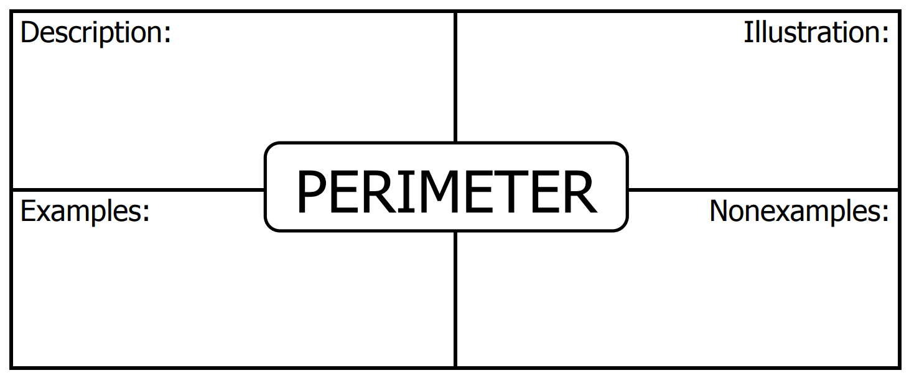
Perimeter Place Mat
Fill in the place mat with your table group
Best one will be put on the wall ☺

Slide 3
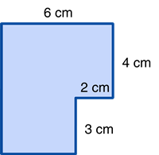
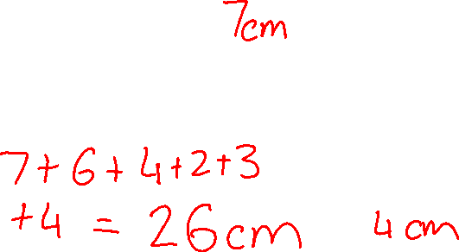
24
7
30
Date
Method
Rectangle
P = 2l + 2w
Square
P = 4l
Perimeter
First find the length of the
unmarked sides.
a = 6 – 2
a = 4 cm
b = 4 + 3
b = 7 cm
b
a

Slide 4
24
7
30
Date
Method
Rectangle
P = 2l + 2w
Square
P = 4l
Perimeter
Then add up all the sides
P = 6 + 4 + 2 + 3
+ 4 + 7
P = 26 cm
7 cm
4 cm

Slide 5
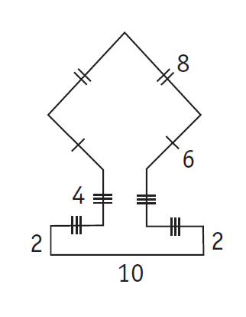
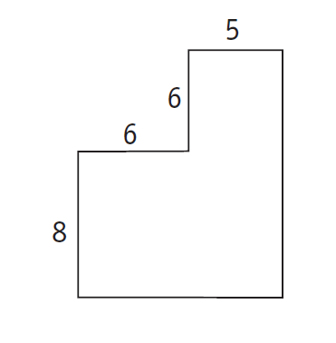
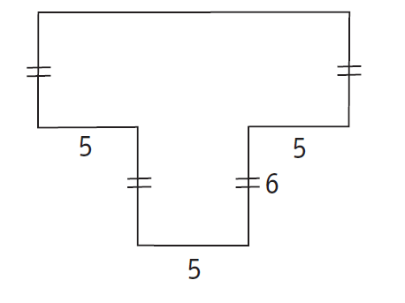
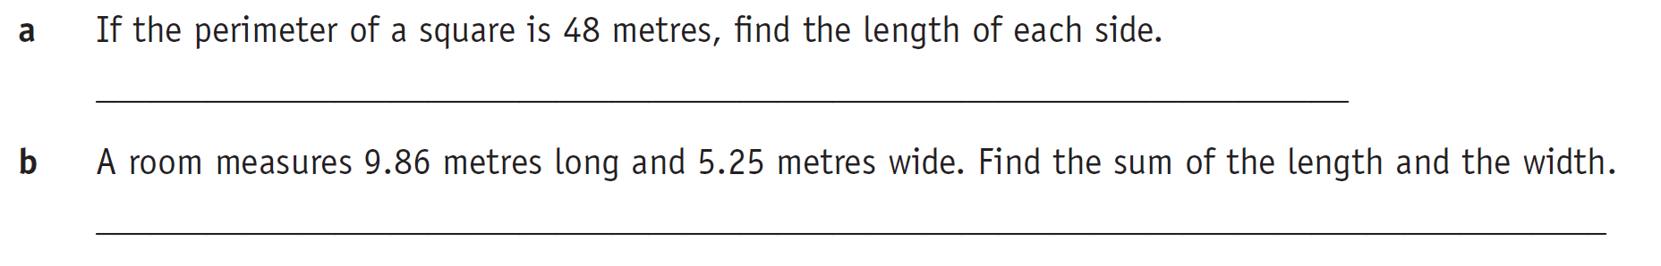

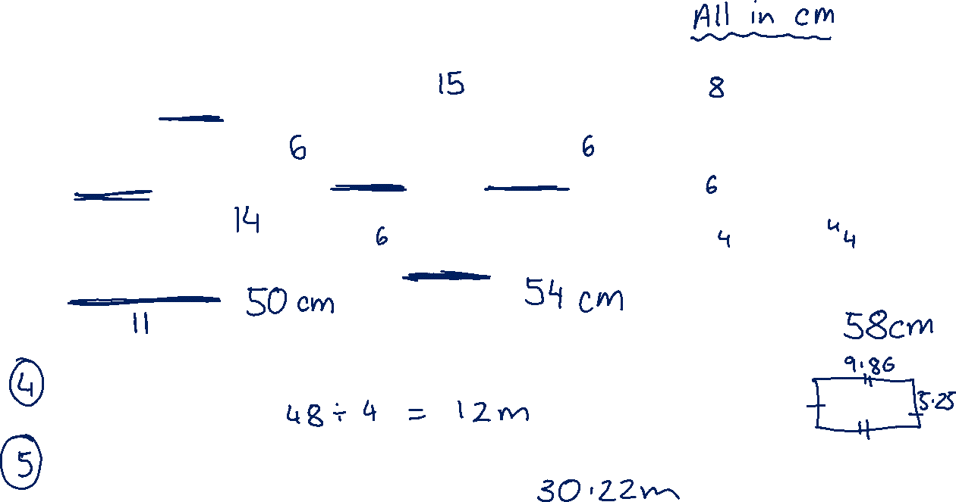
Try these…..find the perimeter

Slide 6
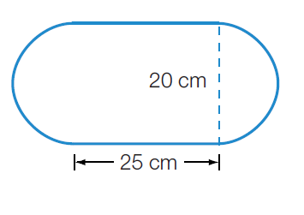
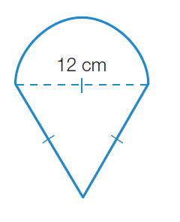
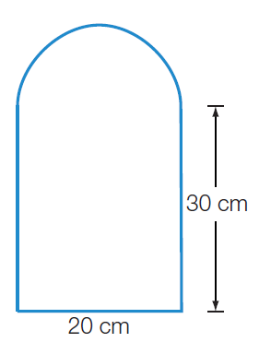
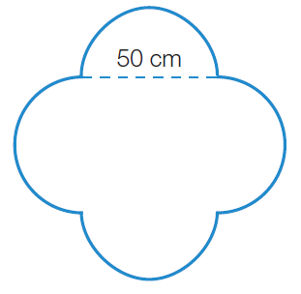
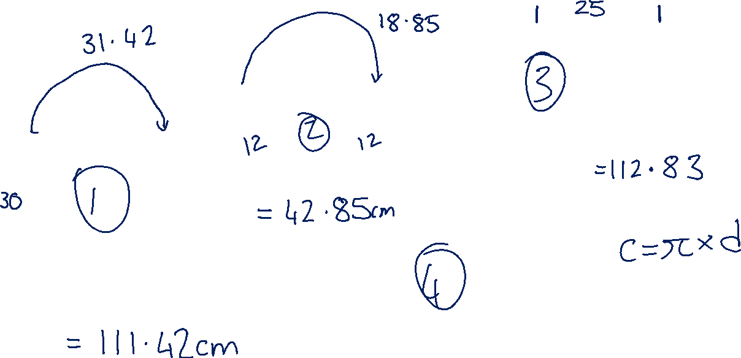
Try these…..find the perimeter

Slide 7
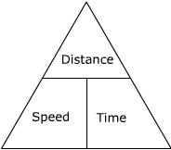
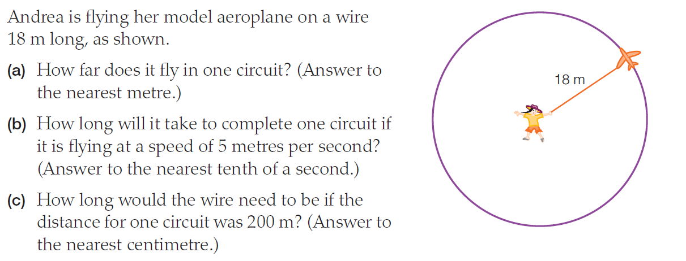
Apply what you know to this question….

